Slide 1
Run-time comparison
Algorithm | Time complexity
Bellman–Ford algorithm | O(VE)
 | O(V² log V)
Dijkstra's algorithm with list | O(V²)
Dijkstra's algorithm with modified binary heap | O(Elog V + Vlog V)
Dijkstra's algorithm with Fibonacci heap | O(E + V log V)
Thorup | O(E + V log log V)
V – number of vertices
E – number of edges

Slide 2
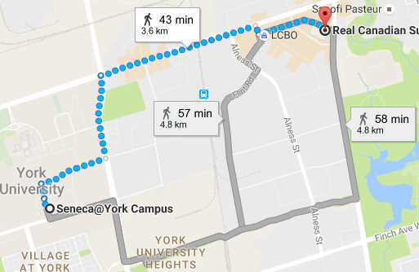
The shortest distance between locations
Vertex – Location
Edge’s weight – Distance / Time between locations
maps.google.ca

Slide 3
Networking
Vertex – Device
Edge’s weight – Number of hops / Access time

Slide 4
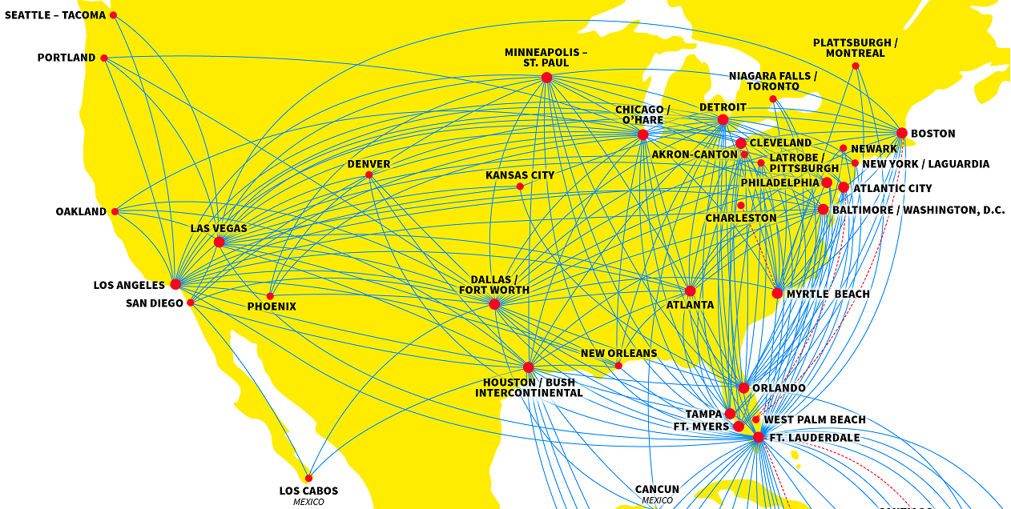
Flight Plans
Vertex – Airport
Edge’s weight – Cost of flight between airports
www.spirit.com/RouteMaps.aspx

Slide 5
Currency Exchange
Vertex – Currency
Edge’s weight – Exchange rate between currencies
 | $ | € | ¥ | £
$ | 1 | 0.9 | 101.23 | 0.76
€ | 1.11 | 1 | 112.55 | 0.85
¥ | 0.0099 | 0.0089 | 1 | 0.0075
£ | 1.31 | 1.18 | 132.94 | 1
¥
$
€
£

Slide 6
Heaps
Operation | Simple list | Binary heap | Fibonacci heap
Find-min | O(N) | Θ(1) | Θ(1)
Delete-min | O(N) | Θ(log N) | O(log N)
Insert | Θ(1) | Θ(log N) | Θ(1)
Decrease-key | - | Θ(log N) | Θ(1)

Slide 7
Path tree
1
8
2
7
3
1
8
2
7
3
4
2
9
4
2
9
11
4
0
8
14
4
0
8
4
7
6
8
10
8
7
6
5
7
6
5
1
2
1
2
Vertex:
0 | 1 | 2 | 3 | 4 | 5 | 6 | 7 | 8
Parent:
-1 | 0 | 1 | 2 | 3 | 6 | 7 | 0 | 2

